Slide 2
Today’s Road Map
What does the MDOT Public Transit Division do?
Division Goals
Program Descriptions
Transit Providers
Project Spotlight
How to Connect

Slide 3
What does MDOT public transit division do?
The Division administer federal and state grant programs and provides technical assistance to state agencies, local governments, as well as public and private non-profit sponsors of transportation programs or projects to develop and maintain coordinated, affordable and accessible mobility options. The Division plan, develop, support and oversee the delivery of a comprehensive transit network with emphasis on accessing services that improve quality of life opportunities.

Slide 4
DIVISION GOALS
To effectively and efficiently serve a broad range of consumers, including the general public as well as to the extent practicable, to serve persons or groups who are eligible for various specialized transportation assistance services.
To support the development of rural general public transportation services that are not restrictive or exclusionary, and;
Ensure the equitable distribution of transportation funds and services in rural areas and small urban communities.

Slide 5
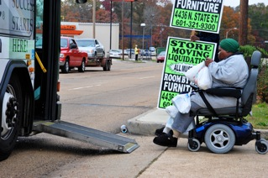
PROGRAM DESCRIPTIONS
5310 Enhanced Mobility of Seniors and Individuals with Disabilities
The goal of the Section 5310 program is to enhance mobility for seniors & persons with disabilities by providing funds for programs to serve the special needs of transit-dependent populations beyond traditional public transportation services & Americans with Disabilities Act complimentary para-transit services

Slide 6
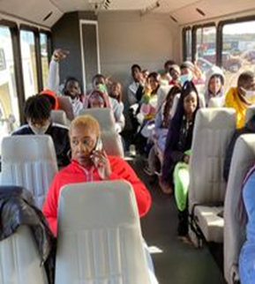
PROGRAM DESCRIPTION-CONTD
5311 Rural Areas Programs
To provide capital, planning, and operating assistance to states to support public transportation including Job Access and Reverse Commute in rural areas with population less than 50,000, where many residents often rely on public transit to reach their destinations.

Slide 7
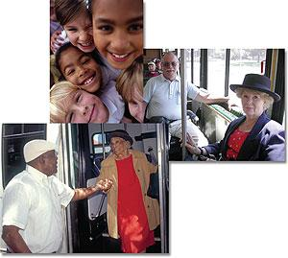
Benefits of Public Transit
Building and maintaining transportation infrastructure in urban and rural areas is imperative to meeting the need for access to jobs, shopping, government services, housing, education, and healthcare within small cities, towns, and their surrounding communities.
Provide better mobility for individuals and targeted groups (e.g. low income, seniors, persons with disabilities or veterans)
Generate jobs, enhance economic growth and support the implementation of public policies relating to areas such as health care, criminal justice recidivism as well as job development and training
Access and mobility are important to developing more vibrant and livable communities across the State.
With the increased emphasis on workforce development efforts (especially job development, training) transit projects have made much success in partnering with employers for trips to employment destination within the state.

Slide 8
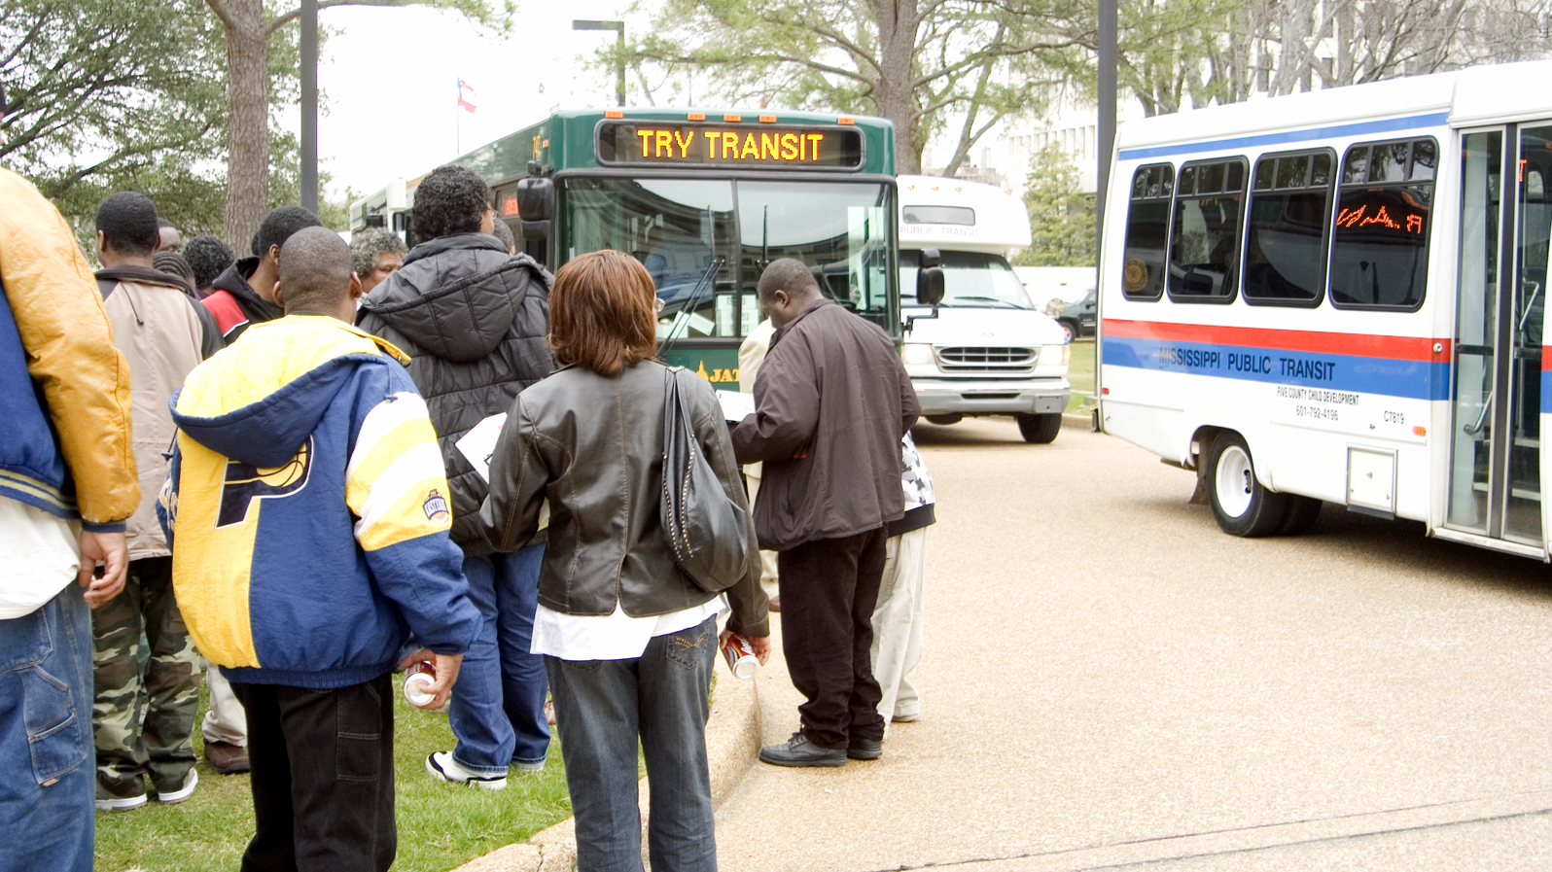
MS TRANSIT PROVIDERS
Total Number of Transit Providers - 67
Programs No of Providers
FTA 5310 42
FTA 5311 23
5311 (F)* 2
* Intercity Bus Operators

Slide 9
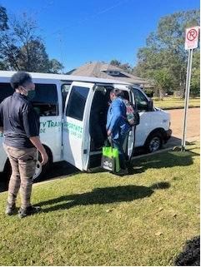
Project Partnership Spotlight Mount Zion Economic Community Center, Inc.
Mount Zion (dba Community Transit (CT)is a non-profit organization that begin transportation services in 2008.
Service Type: Flexible/Demand Response
Service Destinations: employment, education, medical, social services, recreation, grocery shopping etc. Also, non-emergency transportation for medical appointments, and medical prescriptions picked up (Medicaid)
Services Areas: Amite, Franklin, Lincoln, Pike and Wilkerson Counties
Number of vehicles: 20 buses/vans, 12 ADA accessible
Hours of Operation: Monday-Friday, 6:00 am-6:00 p.m. On call Sunday, Saturday.

Slide 10
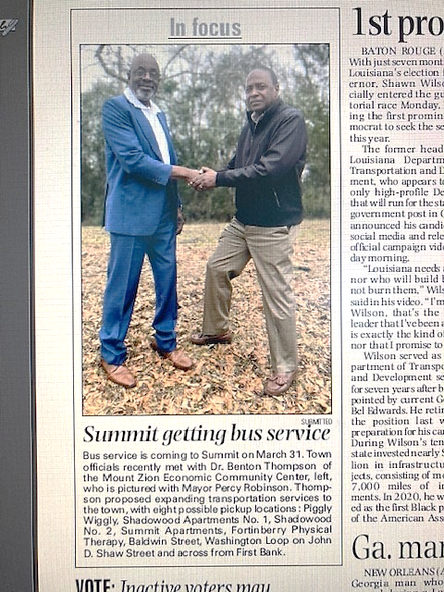
Partnership and Service
New service announcement in the Enterprise Newspaper for Summit, MS
Flexible-service routes for affordable housing complexes:
Shadowood Apartment 1 & 2
Summit Apartments

Slide 11
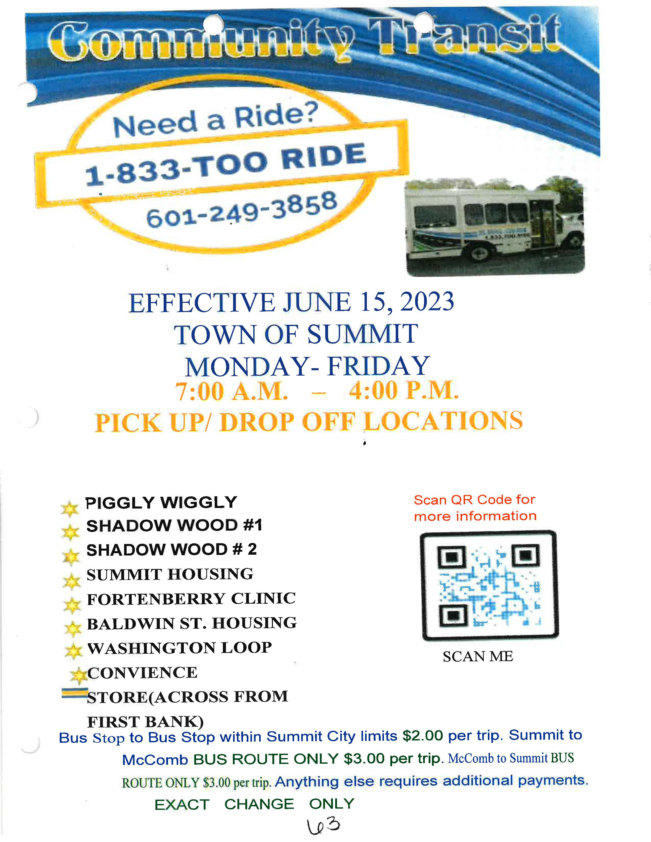
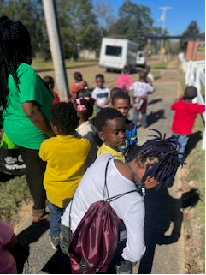
Transportation on the Move
Community Transit Stop at a Housing Complex in Summit, MS

Slide 12
How to Connect to Mobility Options – Regional Mobility Managers
Delta Rides – Doris Green, Calvin Glover
662-846-6161
EZTAG – Jessica Martinez
601-650-7429/601-504-0415
NITA - Tonya Rhea Murphree
662-816-5209/662-234-3540
SMART – Lovie Martin/Michele Johnson
601-445-7568/601-402-5082/601-437-3063
Southern Connect – Donna Bailey, Kevin Hollingsworth
601-682-0701/601-788-2599
TRANSCON – Machelle Kyles, Atesa McKinney
60-960-0719/601-218-7674/601-665-2966

Slide 13
For additional Information
MS Department of Transportation
P.O. Box 1850
Jackson, MS 39215-1850
601-359-7800
Shirley Wilson, Public Transit Director
e-mail: swilson@mdot.ms.gov
Dr. Charles R. Husband – Program Specialist Team Leader
e-mail: chusband@mdot.ms.gov

